Slide 1
Gun violence in America Visualization
Final project
Phi Long Nguyen
n10577505

Slide 2
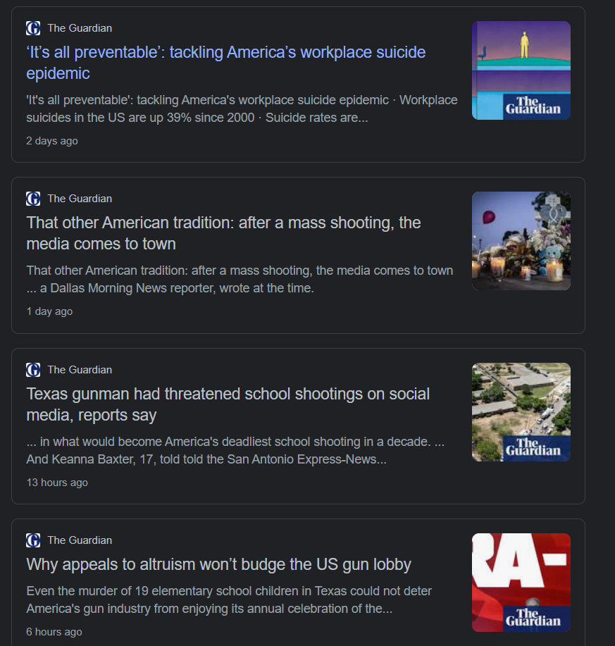
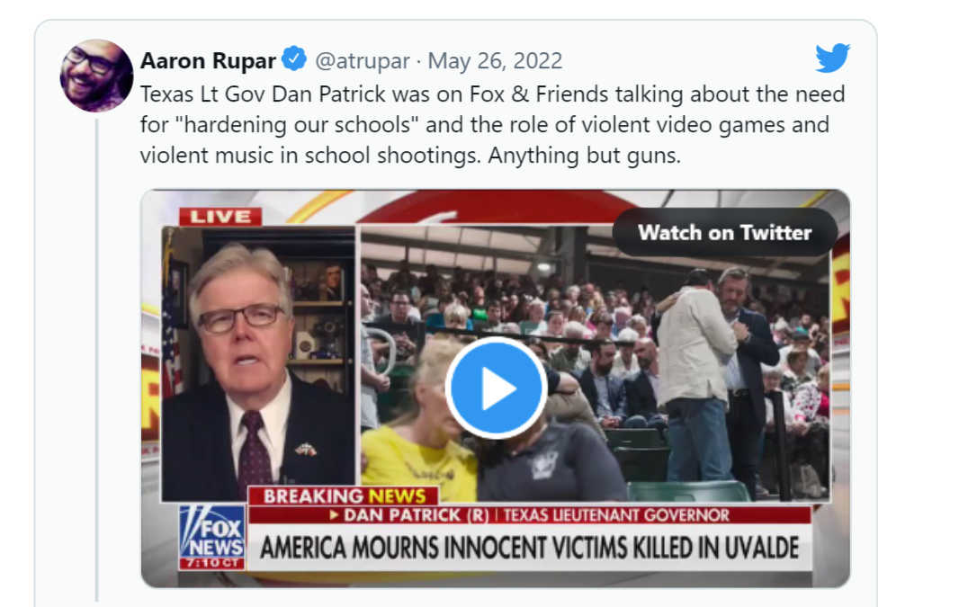
The problem
- Gun violence everywhere in America
Recent school shooting in Texas leaves 21 dead
Schools are becoming more and more dangerous
Mental illness plays a large role in gun violence
Politicians dodge query about gun laws – avoid putting blame on guns

Slide 3
The message – the action – and the audience
To raise awareness, and emphasize on how serious the aforementioned problems are to the general public.
For the politicians, pro-gun peoples to realize and agree how much negative impact guns are causing.
To persuade lawmakers for a stricter gun control law and change pro-gun people opinion.
To put more attention and effort to helping and supporting the mentally ill for the better, as it could help to prevent future shooting.

Slide 4
The dataset
Retrieved from Kaggle:
https://www.kaggle.com/datasets/zusmani/us-mass-shootings-last-50-years
https://www.kaggle.com/datasets/dsp112/us-mass-shootings-dataset-19822021
Both sources record many Mass Shootings that has happen in America across many decades (1960-Present) in slightly different format.
Does not record ALL mass shooting in the history of America.
Main Variables used:
Location – Which State the shooting take place
Year – Year that the incident happens
Race – Killer’s Race
Gender – Killer’s Gender
Age – Killer’s Age
ShootingSite – Which area the killer commit their crime (e.g School, Church…)
Fatalities – Number of people killed
Injured – Number of people injured
Total Victims – Count both fatalities and injured people
Mental_Ilness – Indicate whether the shooter is mentally ill.
Latitude – Latitude of the location
Longitude – Longitude of the location
… and several other unused variables.

Slide 5
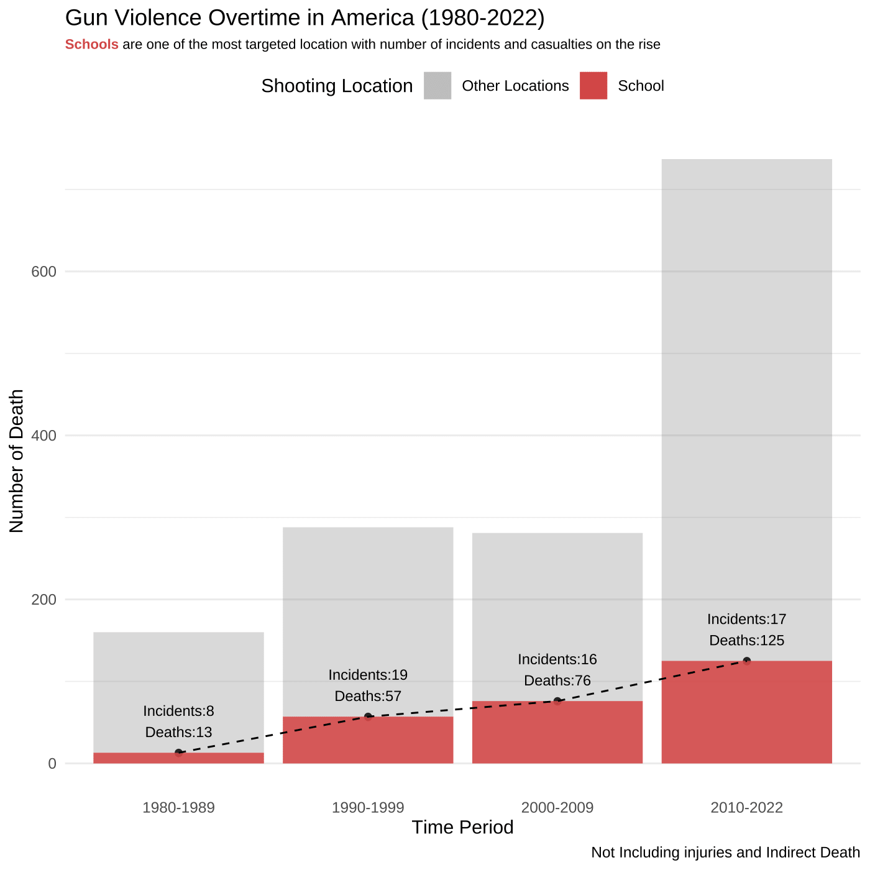
Barchart visualization
When:
Static Image
Top-down order
Title, subtitle, legend then bar chart.
How:
Stacked Bar chart to represent proportion of death for School Shooting vs Other Locations.
Legend to show color for which location.
Use Grey for Other Locations and reduce the opacity slightly to reduce attention
Highlight School by coloring it Red.
Dashed Line with annotation to show the trend.
Extra Note at the bottom
Subtitle indicate the messages of the visualization
What:
Realize and stress that schools are becoming more dangerous for children.
Overall learn that there gun violence is on the rise at alarming rate.

Slide 6
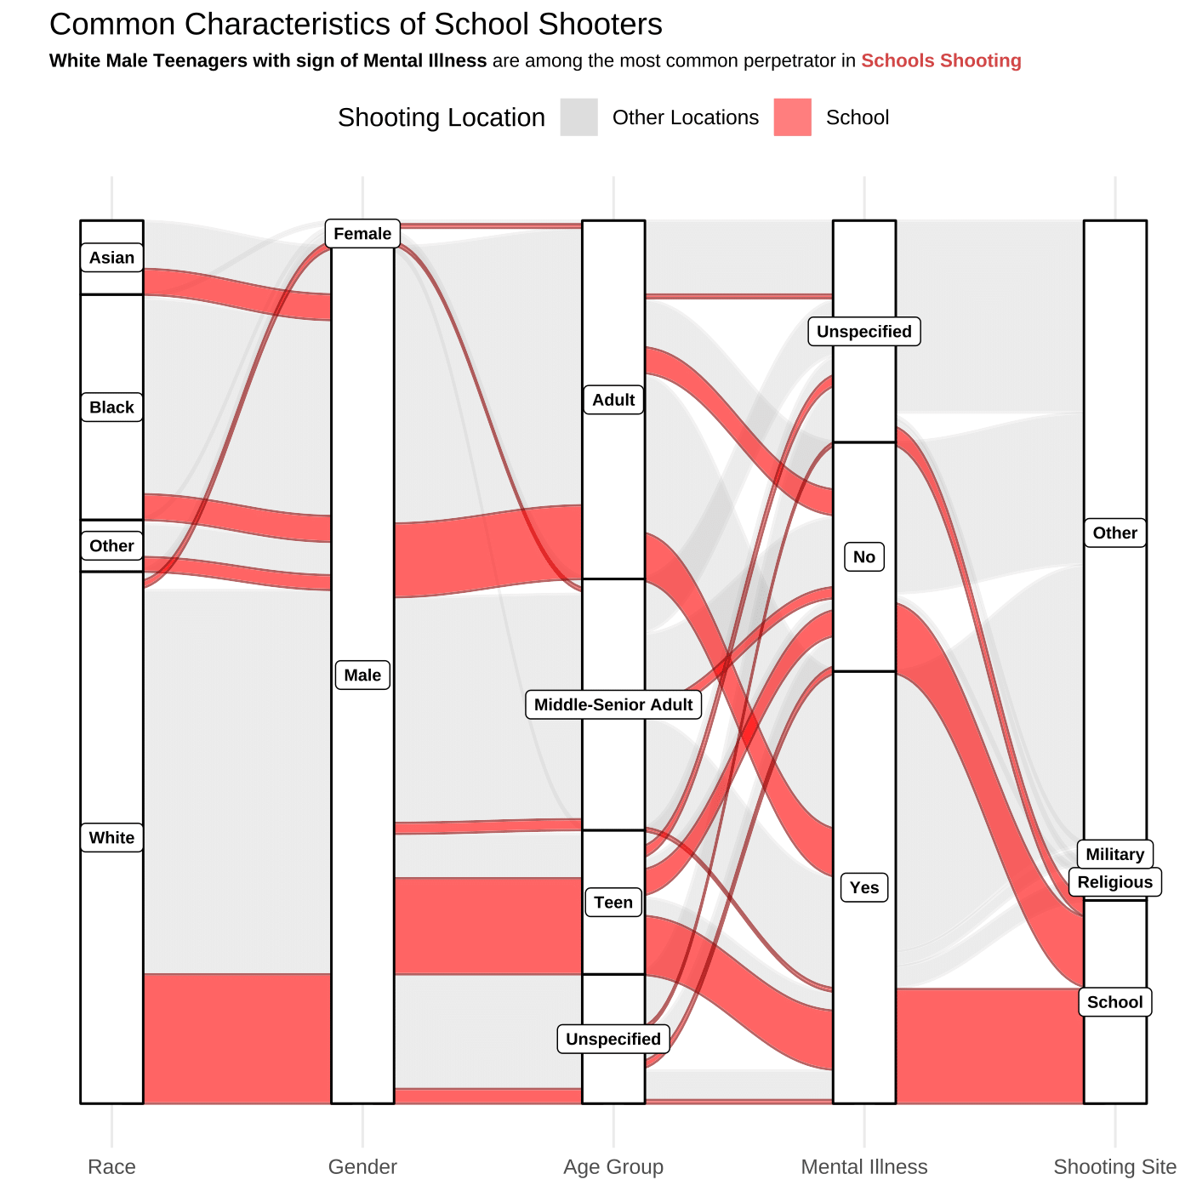
ALLUVIAL visualization
When:
Static Image
Top-down order
Title, subtitle, legend then alluvial plot.
Label for each alluvium at the bottom.
How:
Show proportion of many characteristics of shooter
Legend to show color of Red for characteristics ended up shooting up a school and grey for otherwise
Highlight flow that led School by coloring it Red and grey with reduced opacity for others.
Subtitle to highlight the main message of the visualization.
What:
Realize that many school shooter share common characteristic, as determined in the subtitle.
Educate viewers that Mental Illness contribute to a lot of Shooting incidents.
Call for more attention toward mental illness problem, knowing that it will prevent future school shooting.

Slide 7
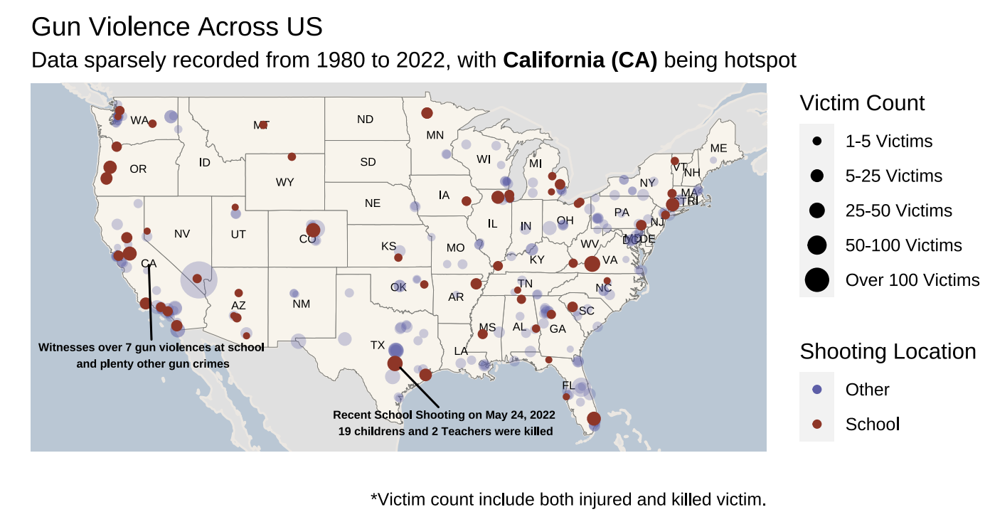
Spatial Map visualization
When:
Static Image
Start with Title & subtitle.
Legends placed on the right
Map in the center
Extra note at the bottom
How:
A map of America, with clear outline of each states.
Legend for size of each point according to number of Victim.
Legend for shooting location, Red for school and Blue for others.
Highlight the point for School Shooting through color red while other points opacity are reduced.
Annotations/labels are used to draw attention to California due to many incidents. Also used to point toward the most recent school shooting in Texas.
What:
Show viewers that there are a lot of gun violence across America, with California having witness most school shooting (base on the dataset).
Remind viewers that the dataset isn’t recorded fully, imagine if the map include every single mass shooting that has happened.
Really urge officials to put stricter gun laws if they want this map to be filled with points.

Slide 8
Main roadblocks
Cleaning and Data Wrangling
Picking Right Visualization
Without proper data, visualization would be ugly and ineffective
Consider the target audience, an unsuitable visualization would causes message to lose meaning

Slide 9
Two recommendations
More In-depth dataset
Add possible information such as the killer’s background information, their household income, or the shooting’s area average income, population and race majority. Also record more incidents.
Animated Spatial Map
To animate the spatial graph of America, showing mass shooting happens over a period of time by having points popping up as time went on. This would overall gives viewer idea of where an incident took place at which time.

Slide 10
Thank you

